Slide 1
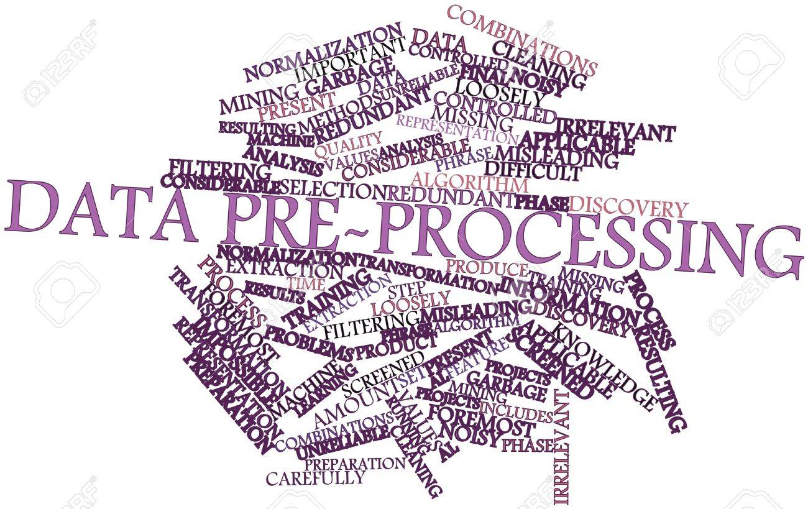
Data Preprocessing
src: https://previews.123rf.com/images/radiantskies/radiantskies1301/radiantskies130101488/17351430-Abstract-word-cloud-for-Data-pre-processing-with-related-tags-and-terms-Stock-Photo.jpg

Slide 2
Data Preprocessing
❑ Key step in data mining process (also known as data preparation)
“Garbage in, garbage out (GIGO)”
❑ Includes cleaning, data reduction, normalization, transformation, feature extraction and selection, etc.
❑ In general, data preparation step takes most of the time and effort (50~80%) during whole process
Raw data in real world are “dirty” per se
Reference: https://en.wikipedia.org/wiki/Data_pre-processing

Slide 3
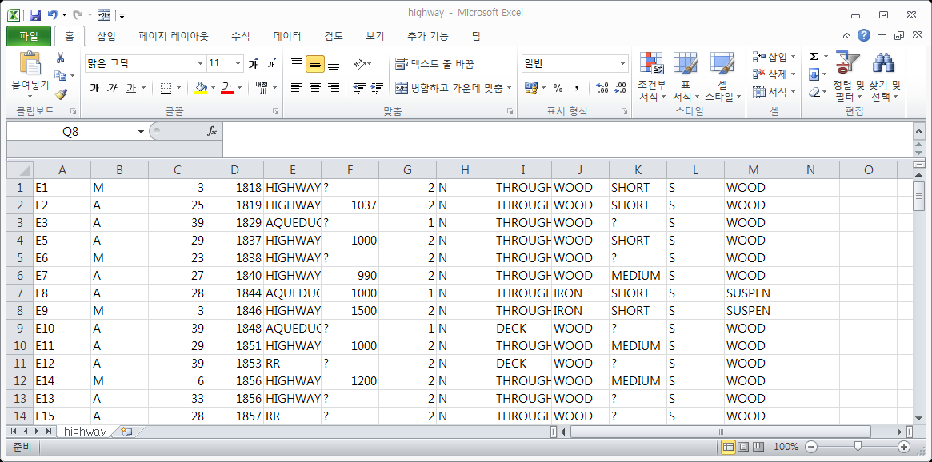
Motivating Examples
❑ Missing Values
Items that are simply non-existent in database
Have to be imputed or deleted

Slide 4
Motivating Examples
❑ Inconsistent Values
Height = 175 ft
Sex: “Male”, Pregnant: “True”
Date Of Birth: 27/09/1889

Slide 5
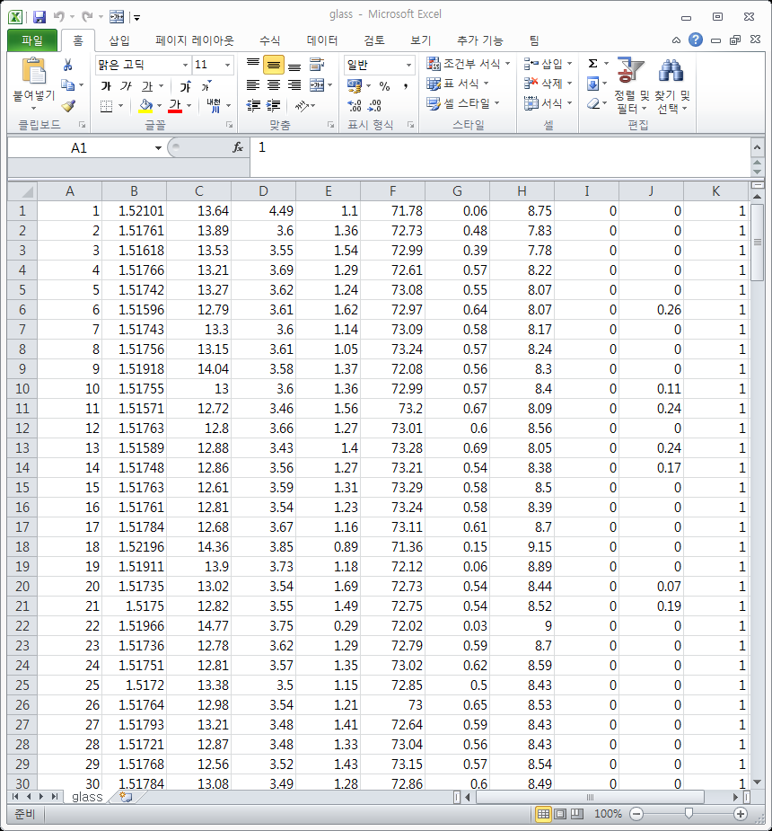
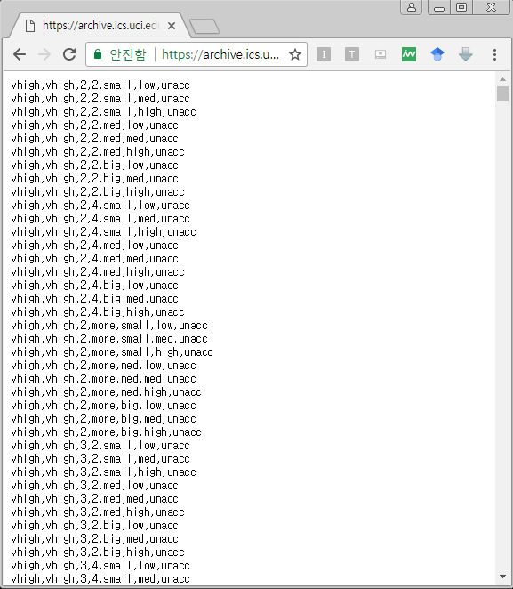
Motivating Examples
❑ Unparsed Data
Parsed Data
Unparsed Data

Slide 6
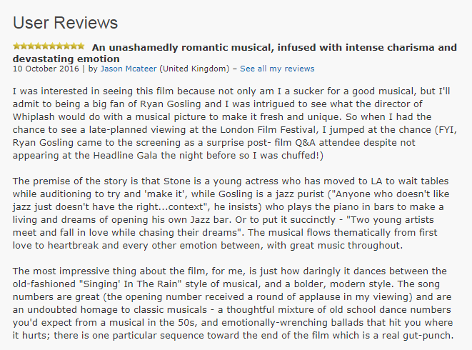

Motivating Examples
❑ Unstructured Data
Structured Data
Movie Title | Director | Budget | Runtime
Pulp Fiction | Quentin Tarantino | $8,000,000 | 154 min
Fight Club | David Fincher | $63,000,000 | 139 min
La La Land | Damien Chazelle | $30,000,000 | 128 min
Unstructured Data

Slide 7
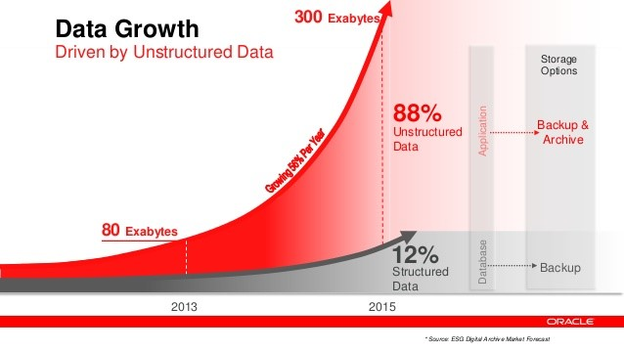
Motivating Examples
❑ Unstructured Data
Most data are unstructured nowadays…
Social Media, Web, Autonomous vehicles, Internet of Things, …
src: https://blog.xively.com/wp-content/uploads/2016/03/Data-Growth_Data-Everywhere-Blog.jpg

Slide 8
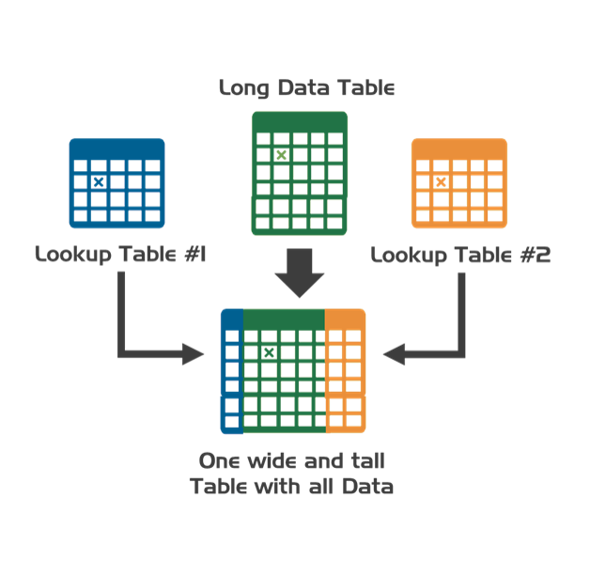
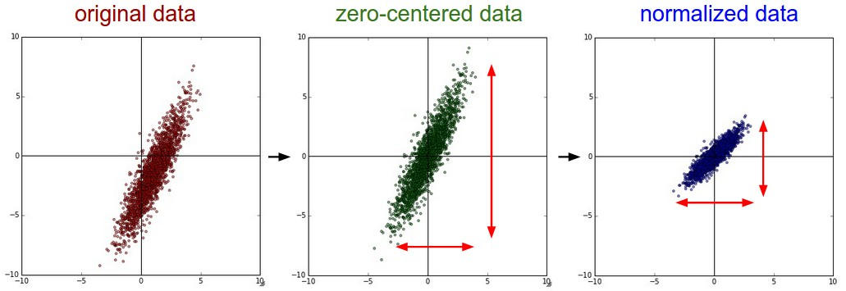
Motivating Examples
❑ Manipulating Data
Many times, we need to manipulate and transform data
Extracting meaningful information, and discarding noise
Merge different sorts of data
Reshaping, normalizing, standardizing, reducing data
src: https://www.extendoffice.com/images/stories/doc-excel/vlookup-merge-two-sheets/doc-vlookup-merge-two-sheets-1.png
http://aikorea.org/cs231n/assets/nn2/prepro1.jpeg

Slide 9
Suggestions
❑ Get used to related Python libraries (included in Anaconda)
Python provides useful libraries for processing data efficiently
NumPy, Pandas, Scikit-learn, BeautifulSoup, …
· Don’t worry, we’ll get used to these for the next few weeks
❑ Try to get as many hands-on experience with data wrangling as possible
Data processing is more like art than science; you have to try out as many as you can
Always remember, real world data is messier than you think!
❑ Some materials to look for…
http://shop.oreilly.com/product/0636920023784.do

